Slide 1
Application of the Ant Colony Algorithm in the Identification of
Globular Clusters
By Jördis Hollander
Supervised by: Prof. Dr. H. Jaeger
Dr. E. Balbinot

Slide 2
Table of Contents
Motivation
Background
Globular Clusters
GAIA DR2 Data-set
Explaining the Pipeline:
Rasterization
Blob Detection using Difference of Gaussian
The Ant Colony Algorithm
Gravitational Pheromone Clustering
Results
Conclusion

Slide 3
Can the Ant Colony Algorithm be used to Identify Globular Clusters?
Why this project?

Slide 4
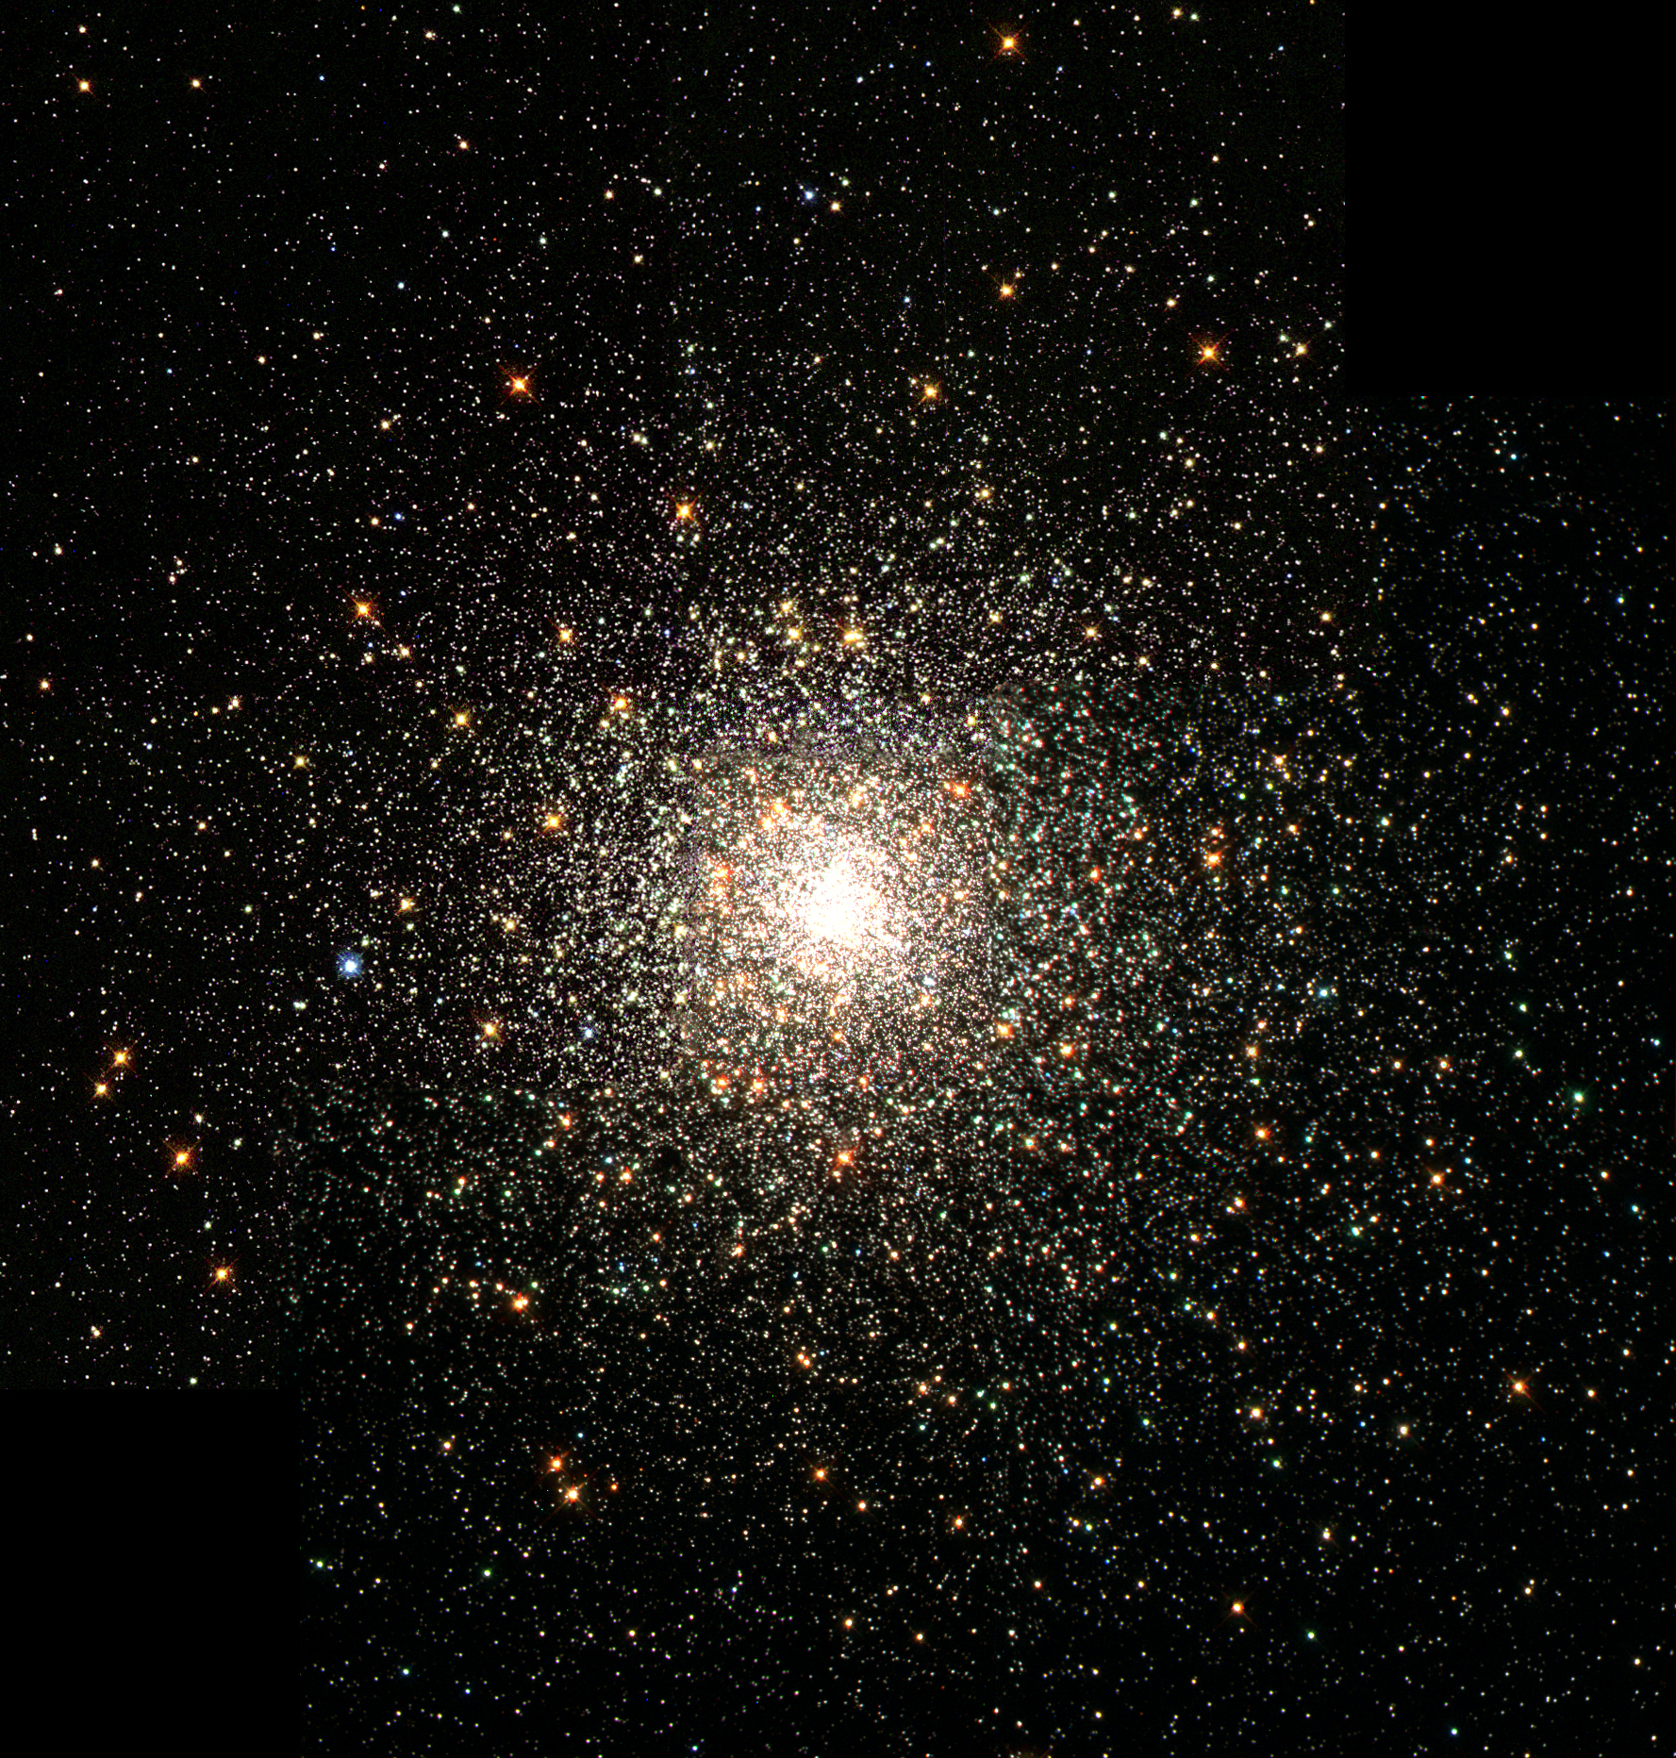
What are Globular Clusters (GCs)?
Globular Clusters are:
Agglomerate collections of stars, that are very tightly bound by gravity.
They demonstrate a high concentration of stars towards their centers.
Many are among the oldest objects in the universe which makes them fascinating and useful to study.
Many GCs are detected by statistical analysis of photometric data using aspects like mean luminosity and metallicity. Such techniques have identified over 150 GCs in our Milky Way.
There is more to say about the attributes that GCs manifest, but only a few properties are focused on in this project.
Messier 80: A GC containing > 100 000 stars †
† By NASA, The Hubble Heritage Team, STScI, AURA - Great Images in NASA Description, Public Domain, https://commons.wikimedia.org/w/index.php?curid=6449278
Notes:
Before I get to Research Question, I want to shortly bring op GCs. What are they?
Globular Clusters are agglomerate collections of stars, that are very tightly bound by gravity. They demonstrate a high concentration of stars towards their centers and many are among the oldest objects of the universe which makes them interesting to study.
There is more to say about the attributes that GCs manifest, but due to the techniques employed, only a few properties are focused on in this project.
Definition + These stellar structures have other properties, however, the ones that I focus on in my paper are:
Their position, drift, and brightness.
Next slide

Slide 5
Data Parameters
Right Ascension (RA)
Declination (Dec)
Parallax (used to compute distance)
Position
Drift
Proper Motion Right Ascension (PMRA)
Proper Motion Declination (PMDec)
Brightness
Apparent Magnitude
The GAIA DR2 dataset is publicly available from the European Space Agency: https://www.cosmos.esa.int/gaia.
Notes:
From the data-set the parameters that encode these properties are;
For the location: The Right Ascension, the Declination, and the parallax, just picture it as (x, y, z)
For the Drift: The Proper Motion Right Ascension, and the Proper Motion Declination, so the movement of a star along (x, y) within a year
And for the brightness: the apparent magnitude.

Slide 6
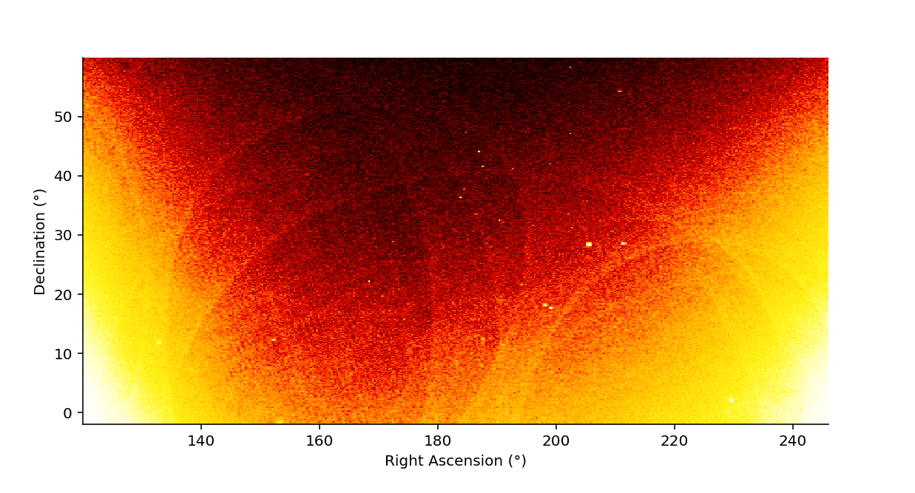
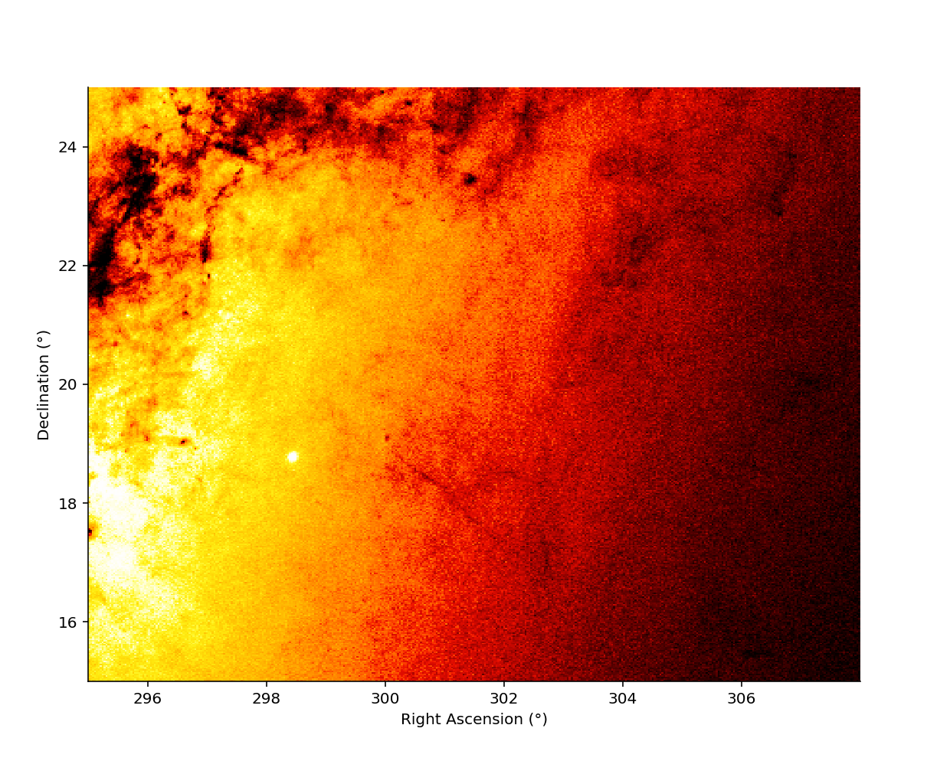
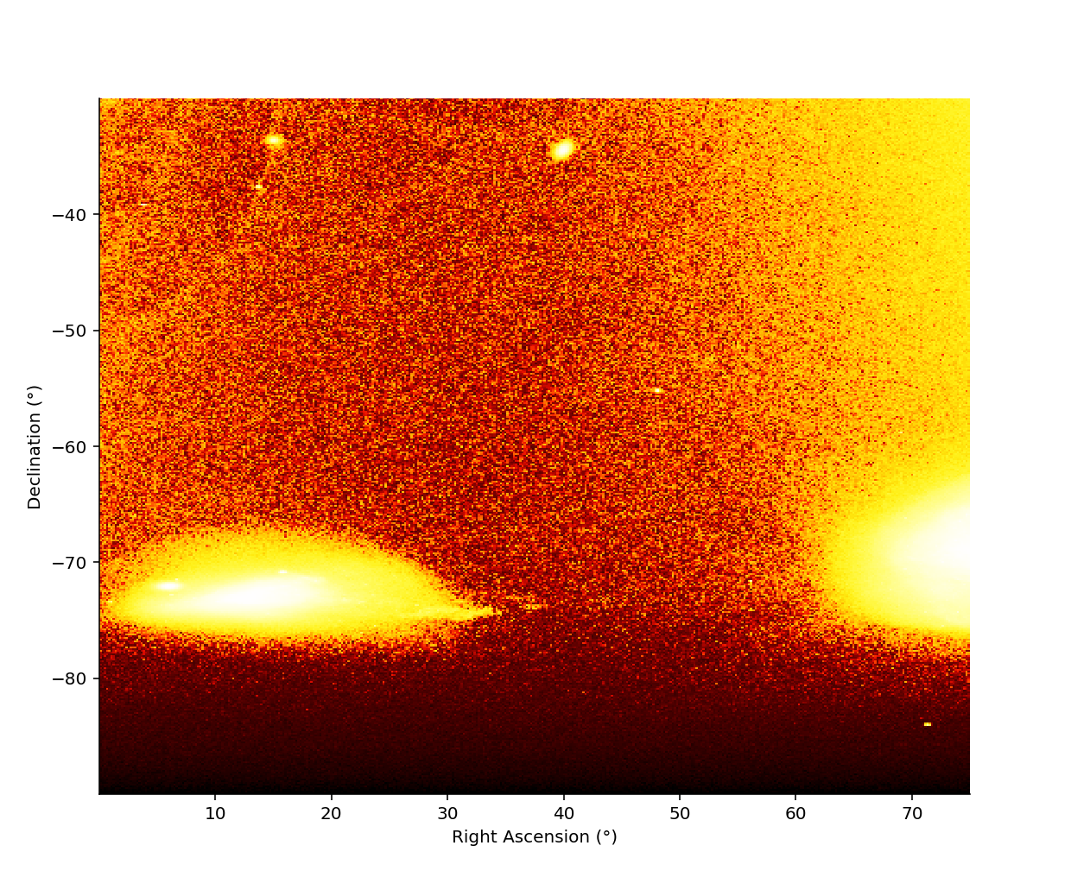
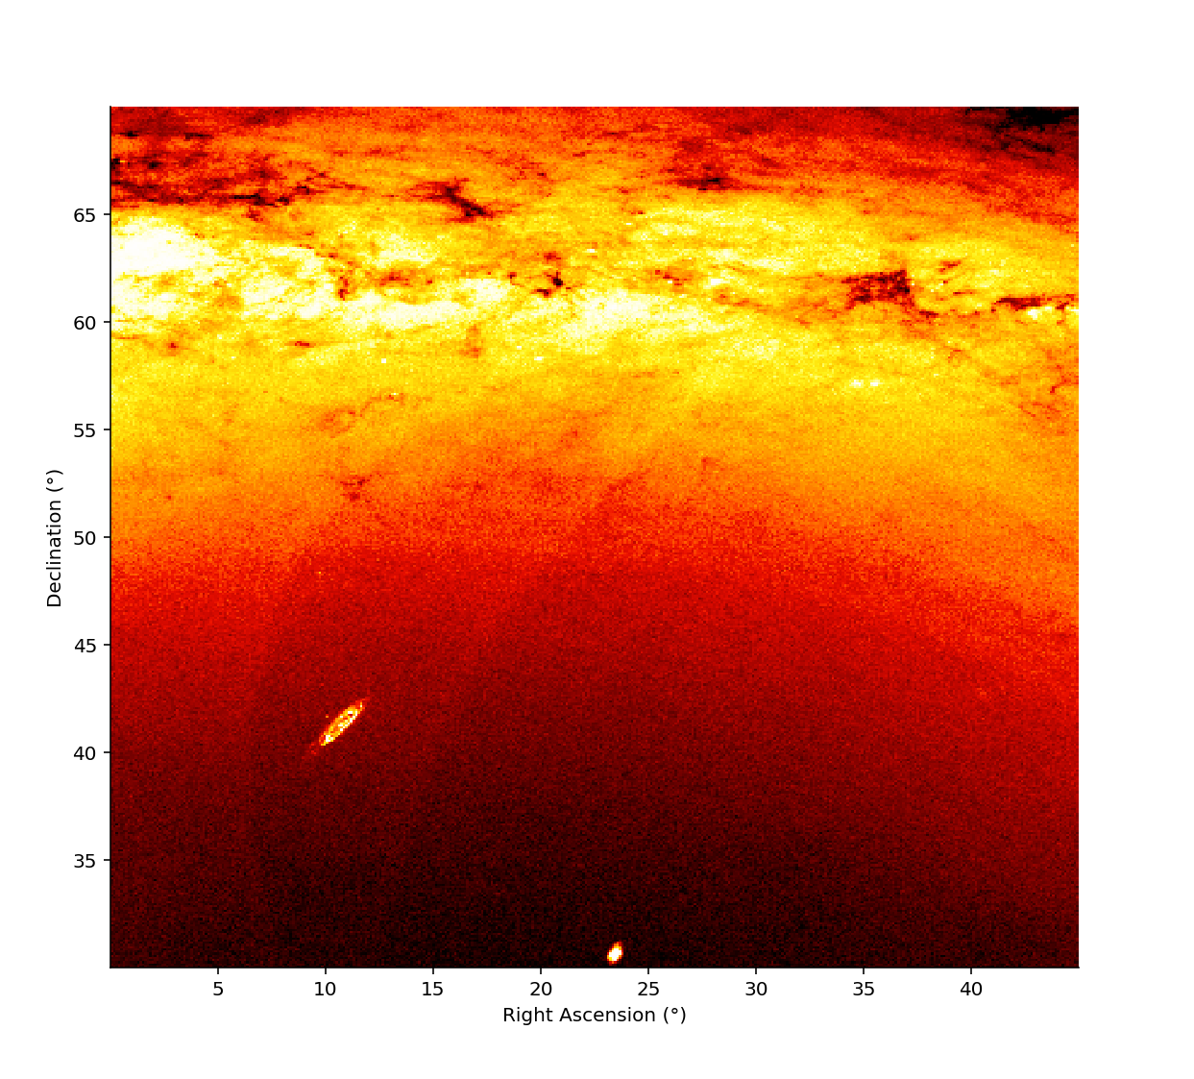
Areas
A1
(12)
A2
(1)
A3 (17)
A4 (None)
Notes:
In my paper, these are the area’s that were looked at.
These images are generated scatterplots based on the apparent magnitudes of the stars.
I expected that the raster expulsion method, i.e. BlobDoG, would only do a rough elimination of the rasters that contain no stellar structures that could be considered blobs.
I expected that the Ant Colony algorithm would work well on placing the GCs of Area 1. I expected it would paint a confused picture in Area 2 due to the huge number of stars, and that it would either find clusters everywhere or non at all. I was not sure how the algorithm would respond to Area 3 because it has both densely pact areas and other variety. Lastly in Area 4 I expected it would find the Galaxies and maybe some other structures.

Slide 7
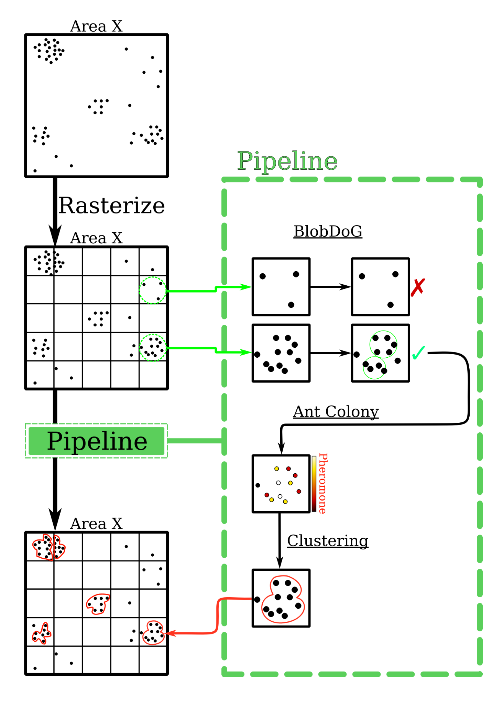
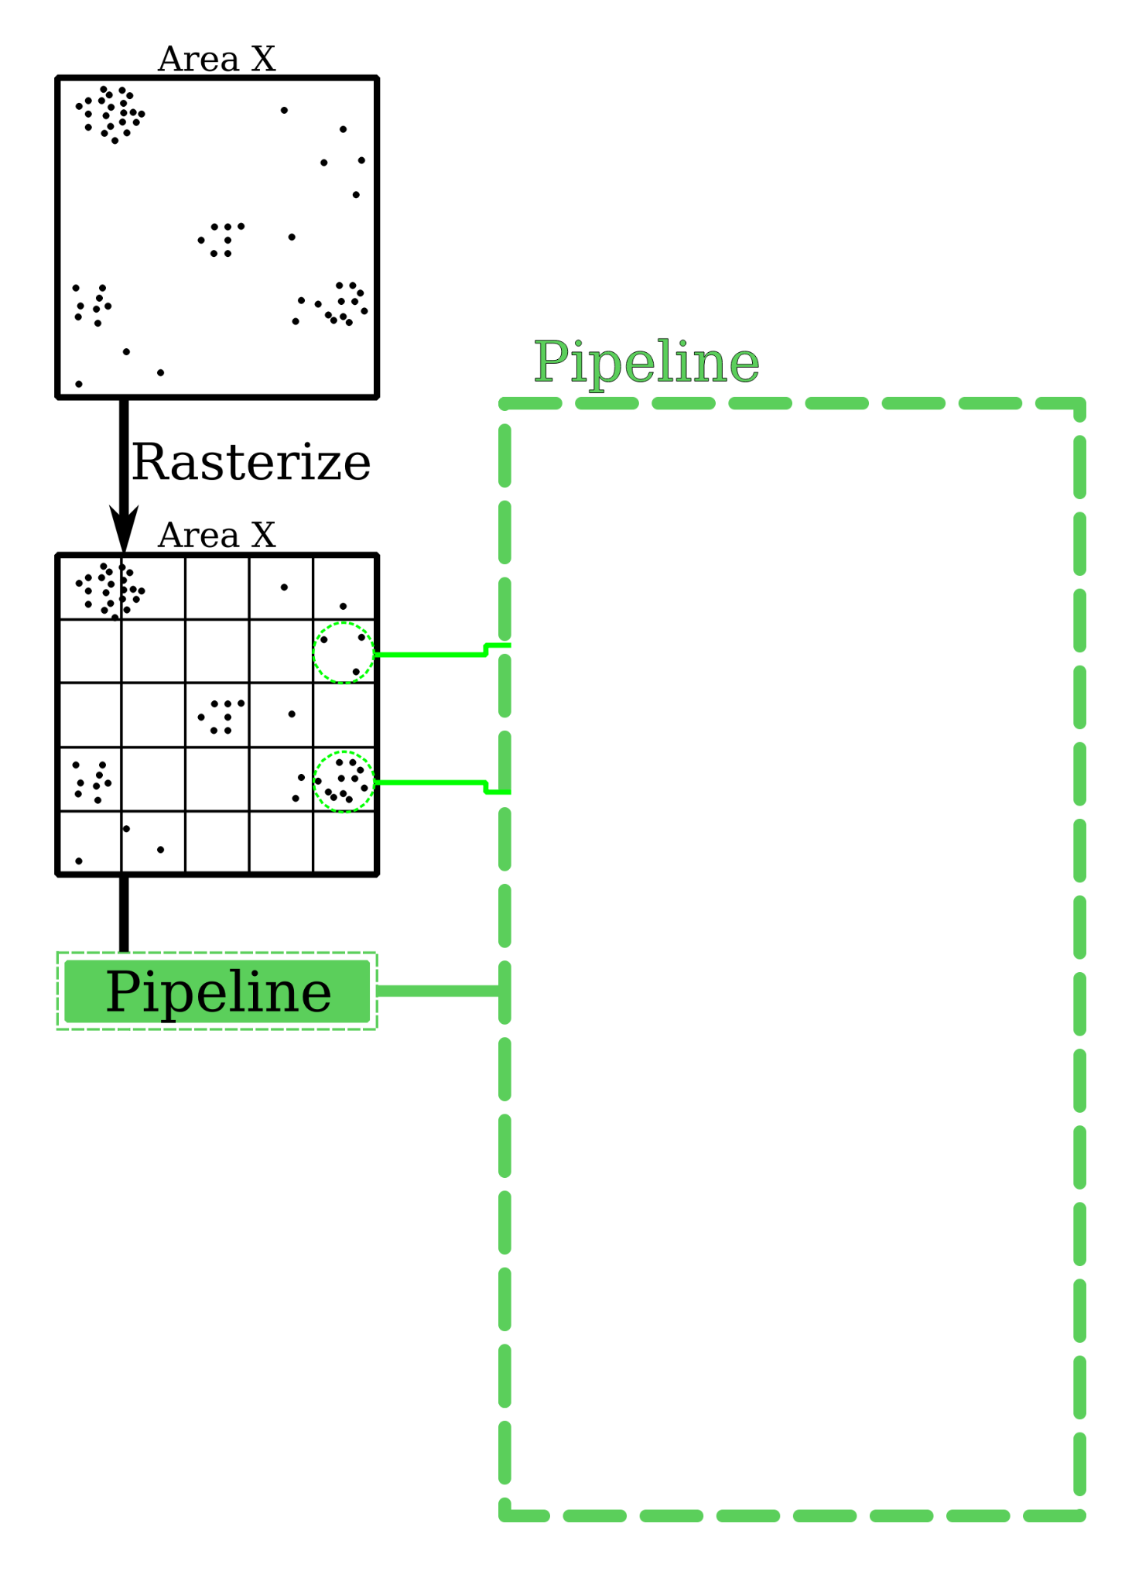
The Pipeline
Notes:
So, now dealing with the description of the pipeline
We begin with some area, due to the size of the areas that were selected, we must first begin by subdividing this area in smaller regions.
This proces is rasterization, and these regions are called rasters.
These smaller rasters are then run throught the main identification pipeline.
First, the rasters that are mostly devoid of stars are filtered away via the blobdog exclusion criteria.
This makes use of difference of Gaussian at varying scales to identify potential blobs.
Rasters for which no blobs are identified are discarded and rasters where at least one blob was found are then forwarded to the next pipeline.
In this next stage, a pheromone map is generated by the Ant Colony random-walk algorithm. The ants favour stars that are near to the current star and that are moving with a similar drift. This distribution is then used by the Clustering algorithm to identify potential clusters. This is done by, selecting the stars with the highest pheromone values and generating a field around them relative to their strength of their pheromone value. Stars that fall under this field are then added to that cluster. Each addition shifts the center-of-gravity of the cluster and increases its total pheromone mass. This increase in “mass”, increases the size of its field.
This continue in this fashion until the cluster stop growing.
(Extra Note in case they ask. All stars end up being clustered. But some are tiny clusters of very few stars. There is a filter of 100 stars. Clusters less than this are discarded. Other properties other than simply the number of stars could also be used to filter these clusters further.)

Slide 8
The Pipeline
Notes:
So, now dealing with the description of the pipeline
We begin with some area, due to the size of the areas that were selected, we must first begin by subdividing this area in smaller regions.
This proces is rasterization, and these regions are called rasters.
These smaller rasters are then run throught the main identification pipeline.
First, the rasters that are mostly devoid of stars are filtered away via the blobdog exclusion criteria.
This makes use of difference of Gaussian at varying scales to identify potential blobs.
Rasters for which no blobs are identified are discarded and rasters where at least one blob was found are then forwarded to the next pipeline.
In this next stage, a pheromone map is generated by the Ant Colony random-walk algorithm. The ants favour stars that are near to the current star and that are moving with a similar drift. This distribution is then used by the Clustering algorithm to identify potential clusters. This is done by, selecting the stars with the highest pheromone values and generating a field around them relative to their strength of their pheromone value. Stars that fall under this field are then added to that cluster. Each addition shifts the center-of-gravity of the cluster and increases its total pheromone mass. This increase in “mass”, increases the size of its field.
This continue in this fashion until the cluster stop growing.
(Extra Note in case they ask. All stars end up being clustered. But some are tiny clusters of very few stars. There is a filter of 100 stars. Clusters less than this are discarded. Other properties other than simply the number of stars could also be used to filter these clusters further.)

Slide 9
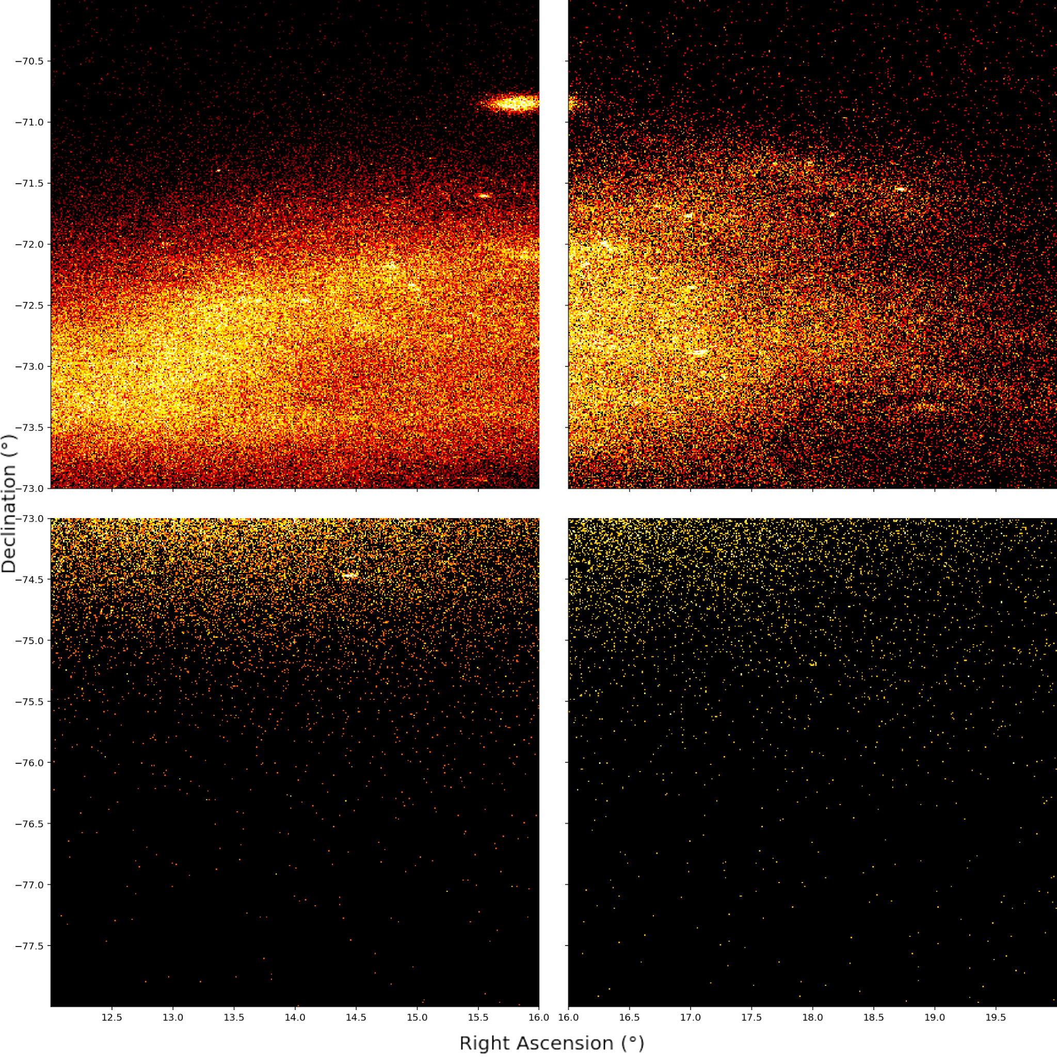
Rasterization
This process cuts each area into uniform regions delimited by Right Ascension and Declination.
The rasterization scheme was primarily 4°×4° but a 2°×2° scheme was explored for Area 2.
Benefits of the rasterization:
The rasters can be processed in parallel.
The Ant Colony algorithm operates more effectively on smaller regions.
Initial filtration by a faster algorithm before the more computationally intensive phases of the pipeline.
Notes:
{Add as a speaker note} about how the rasterization scheme is fixed and how this could cut a GC at a raster boundary.
This faster algorithm that was employed is the next phase of the pipeline, click to it in the pipeline and then say "BlobDoG”

Slide 10
The Pipeline
Notes:
So, now dealing with the description of the pipeline
We begin with some area, due to the size of the areas that were selected, we must first begin by subdividing this area in smaller regions.
This proces is rasterization, and these regions are called rasters.
These smaller rasters are then run throught the main identification pipeline.
First, the rasters that are mostly devoid of stars are filtered away via the blobdog exclusion criteria.
This makes use of difference of Gaussian at varying scales to identify potential blobs.
Rasters for which no blobs are identified are discarded and rasters where at least one blob was found are then forwarded to the next pipeline.
In this next stage, a pheromone map is generated by the Ant Colony random-walk algorithm. The ants favour stars that are near to the current star and that are moving with a similar drift. This distribution is then used by the Clustering algorithm to identify potential clusters. This is done by, selecting the stars with the highest pheromone values and generating a field around them relative to their strength of their pheromone value. Stars that fall under this field are then added to that cluster. Each addition shifts the center-of-gravity of the cluster and increases its total pheromone mass. This increase in “mass”, increases the size of its field.
This continue in this fashion until the cluster stop growing.
(Extra Note in case they ask. All stars end up being clustered. But some are tiny clusters of very few stars. There is a filter of 100 stars. Clusters less than this are discarded. Other properties other than simply the number of stars could also be used to filter these clusters further.)

Slide 11
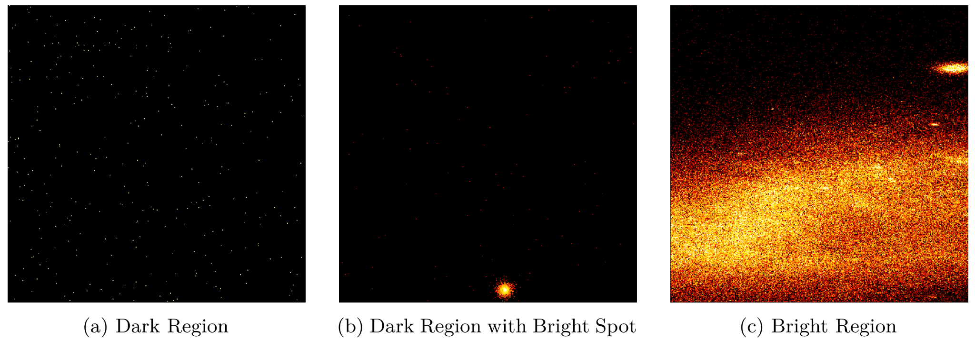
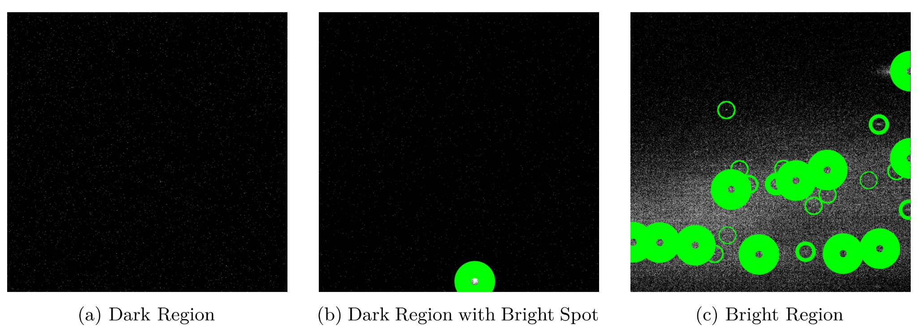
BlobDoG
It finds blobs:
If for some raster, it does not, then that raster is not a candidate for further exploration.
Based on applying DoG edge detection at different scales to find the right “focus” to discover a blob.
Blobs whose size are below a minimal threshold are discarded.
The threshold was set to 0.2 based on experiments aiming for the optimum retention of globular clusters.
Notes:
As a note: this was used as a post-processing filter step by Mohammadi et al. This was used in that same way as a pre-processing step but also serves double-duty as it improves the runtime of the pipeline.
The threshold was set to 0.2 based on experiments looking for optimum retention of globular clusters.

Slide 12
The Pipeline
Notes:
So, now dealing with the description of the pipeline
We begin with some area, due to the size of the areas that were selected, we must first begin by subdividing this area in smaller regions.
This proces is rasterization, and these regions are called rasters.
These smaller rasters are then run throught the main identification pipeline.
First, the rasters that are mostly devoid of stars are filtered away via the blobdog exclusion criteria.
This makes use of difference of Gaussian at varying scales to identify potential blobs.
Rasters for which no blobs are identified are discarded and rasters where at least one blob was found are then forwarded to the next pipeline.
In this next stage, a pheromone map is generated by the Ant Colony random-walk algorithm. The ants favour stars that are near to the current star and that are moving with a similar drift. This distribution is then used by the Clustering algorithm to identify potential clusters. This is done by, selecting the stars with the highest pheromone values and generating a field around them relative to their strength of their pheromone value. Stars that fall under this field are then added to that cluster. Each addition shifts the center-of-gravity of the cluster and increases its total pheromone mass. This increase in “mass”, increases the size of its field.
This continue in this fashion until the cluster stop growing.
(Extra Note in case they ask. All stars end up being clustered. But some are tiny clusters of very few stars. There is a filter of 100 stars. Clusters less than this are discarded. Other properties other than simply the number of stars could also be used to filter these clusters further.)

Slide 13
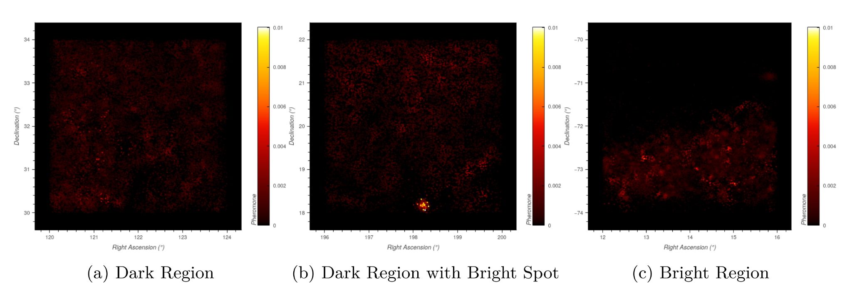
Ant Colony
Each star has a weight computed, based on its position and drift.
This weight is used by the Ant Colony algorithm to generate a pheromone mapping of the stars within the raster.
Regions with a higher proportion of similar stars will be visited by more ants than regions with a lower proportion of stars.
Connecting these pheromone values reveal the network substructure discovered by the ants.

Slide 14
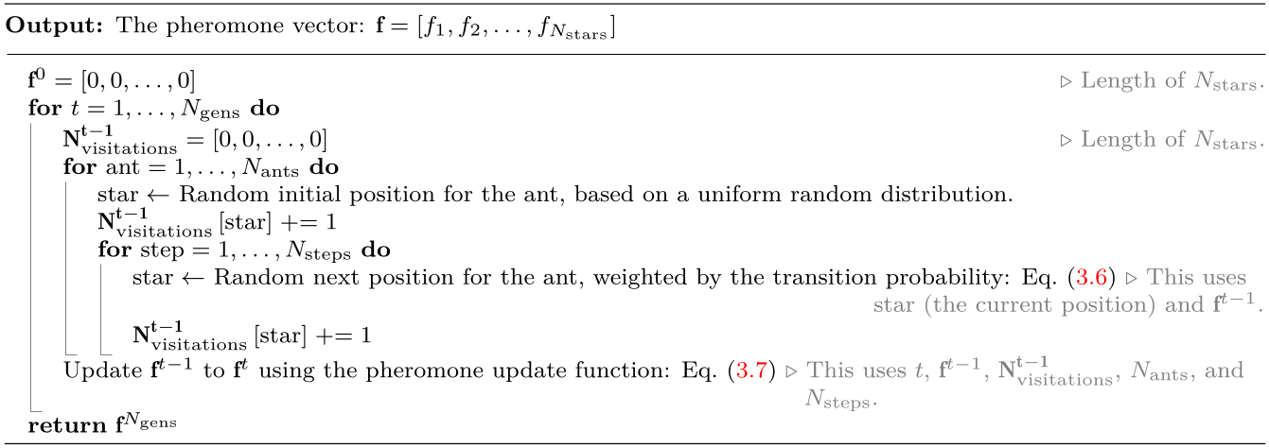
Ant Colony Algorithm
🠖
🠖
🠖
🠖
🠖
🠖
🠖
🠖

Slide 15
The Pipeline
Notes:
So, now dealing with the description of the pipeline
We begin with some area, due to the size of the areas that were selected, we must first begin by subdividing this area in smaller regions.
This proces is rasterization, and these regions are called rasters.
These smaller rasters are then run throught the main identification pipeline.
First, the rasters that are mostly devoid of stars are filtered away via the blobdog exclusion criteria.
This makes use of difference of Gaussian at varying scales to identify potential blobs.
Rasters for which no blobs are identified are discarded and rasters where at least one blob was found are then forwarded to the next pipeline.
In this next stage, a pheromone map is generated by the Ant Colony random-walk algorithm. The ants favour stars that are near to the current star and that are moving with a similar drift. This distribution is then used by the Clustering algorithm to identify potential clusters. This is done by, selecting the stars with the highest pheromone values and generating a field around them relative to their strength of their pheromone value. Stars that fall under this field are then added to that cluster. Each addition shifts the center-of-gravity of the cluster and increases its total pheromone mass. This increase in “mass”, increases the size of its field.
This continue in this fashion until the cluster stop growing.
(Extra Note in case they ask. All stars end up being clustered. But some are tiny clusters of very few stars. There is a filter of 100 stars. Clusters less than this are discarded. Other properties other than simply the number of stars could also be used to filter these clusters further.)

Slide 16
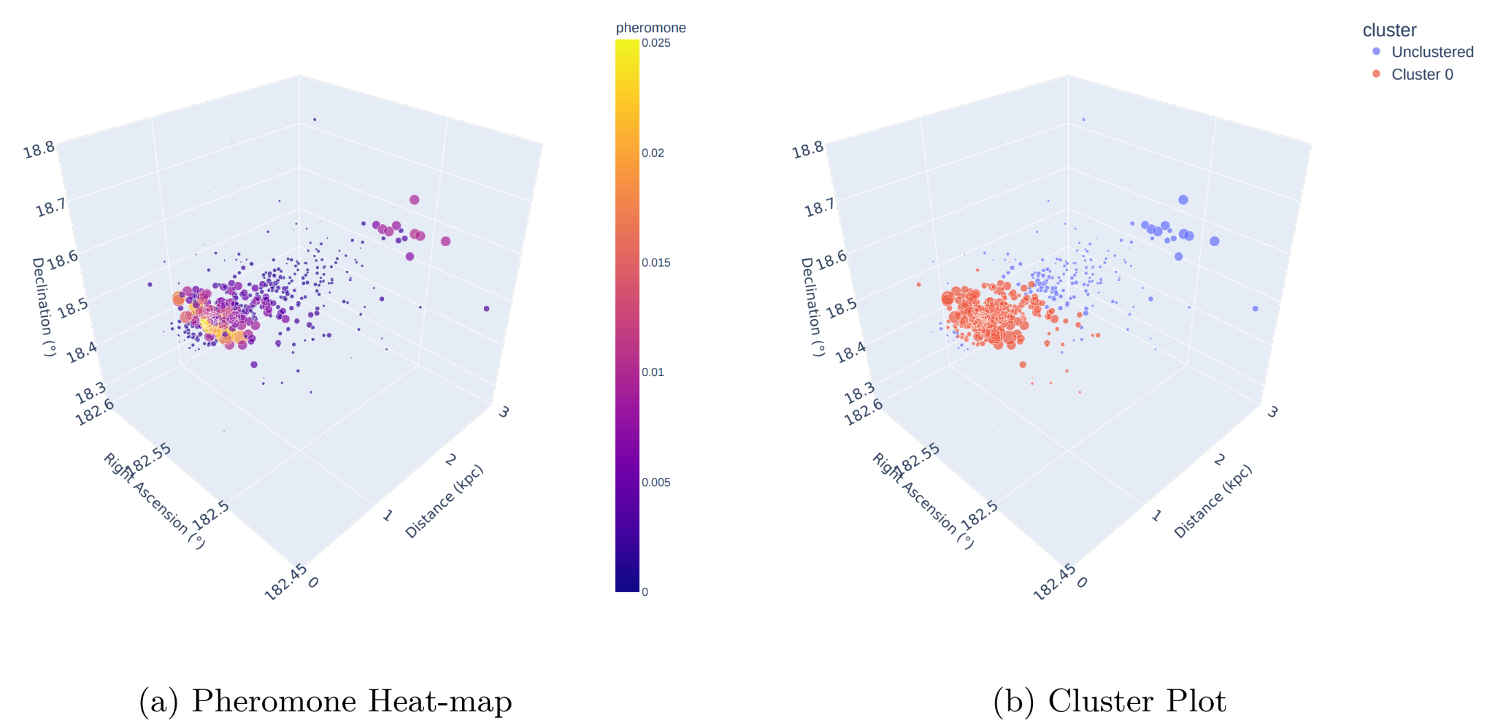
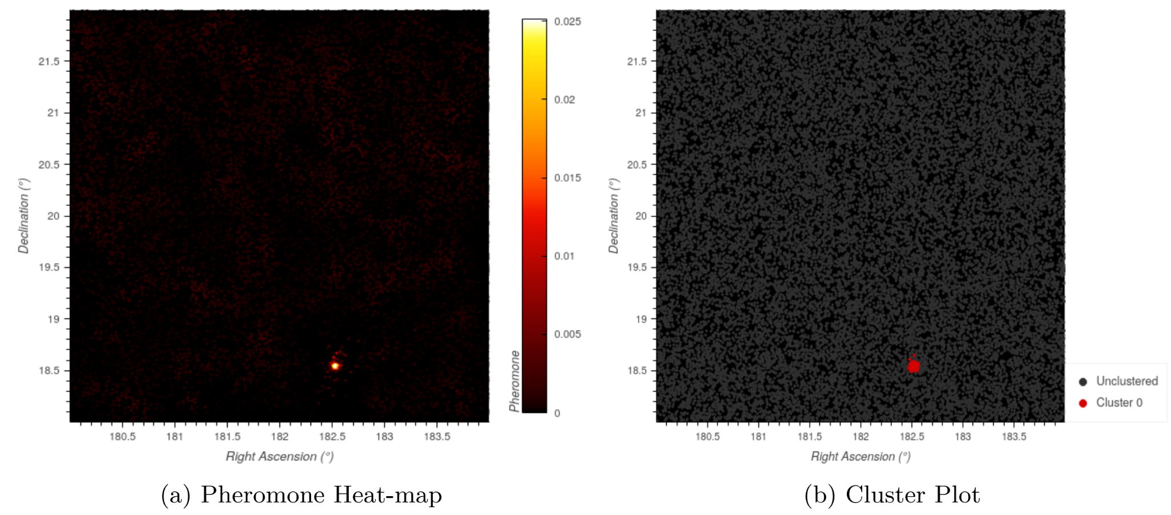
Clustering

Slide 17
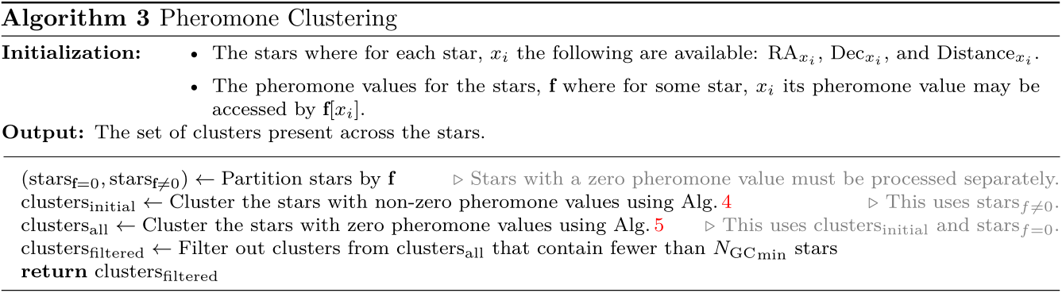
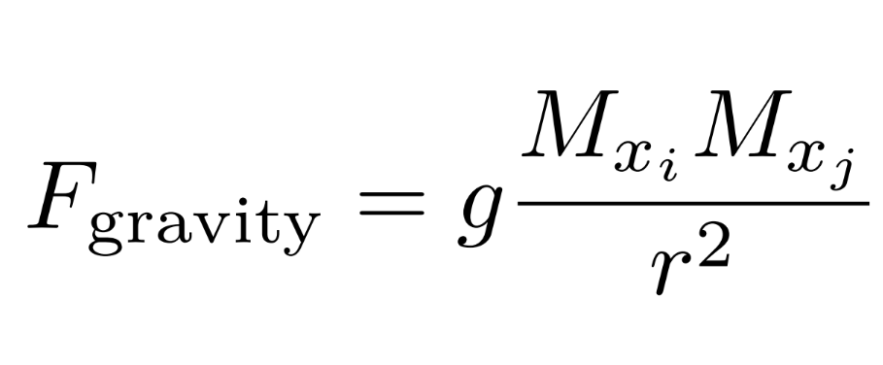
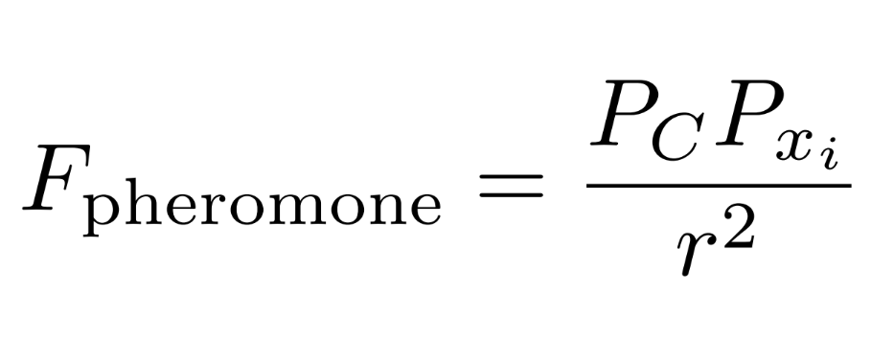
Main Clustering Algorithm

Slide 18
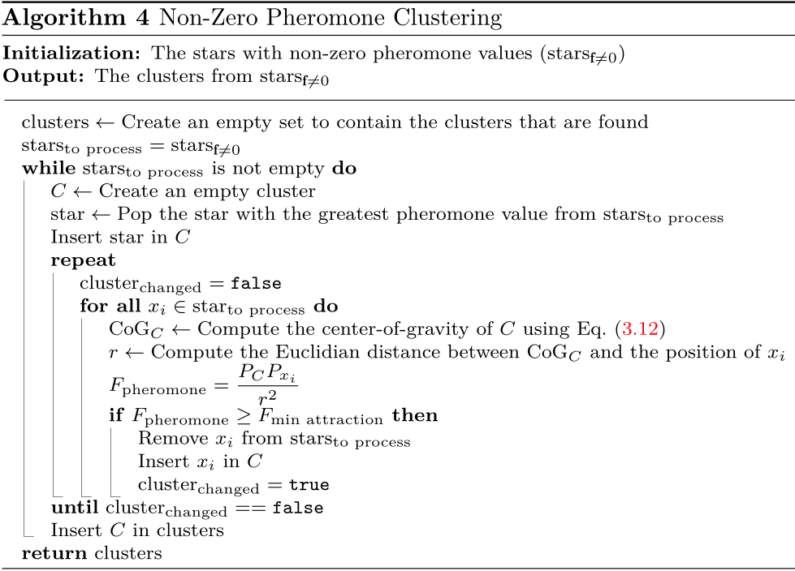
Process each star from the largest to smallest pheromone value (order of influence).
This star forms a cluster, grow this cluster around its center of gravity.
Each new star increases its field strength.
Do this until the cluster no longer grows.
Do this until all stars are processed.

Slide 19
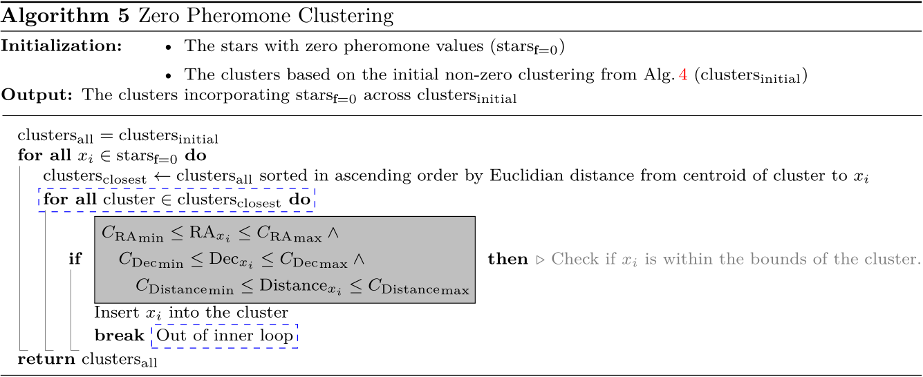

Slide 20
The Pipeline
Notes:
So, now dealing with the description of the pipeline
We begin with some area, due to the size of the areas that were selected, we must first begin by subdividing this area in smaller regions.
This proces is rasterization, and these regions are called rasters.
These smaller rasters are then run throught the main identification pipeline.
First, the rasters that are mostly devoid of stars are filtered away via the blobdog exclusion criteria.
This makes use of difference of Gaussian at varying scales to identify potential blobs.
Rasters for which no blobs are identified are discarded and rasters where at least one blob was found are then forwarded to the next pipeline.
In this next stage, a pheromone map is generated by the Ant Colony random-walk algorithm. The ants favour stars that are near to the current star and that are moving with a similar drift. This distribution is then used by the Clustering algorithm to identify potential clusters. This is done by, selecting the stars with the highest pheromone values and generating a field around them relative to their strength of their pheromone value. Stars that fall under this field are then added to that cluster. Each addition shifts the center-of-gravity of the cluster and increases its total pheromone mass. This increase in “mass”, increases the size of its field.
This continue in this fashion until the cluster stop growing.
(Extra Note in case they ask. All stars end up being clustered. But some are tiny clusters of very few stars. There is a filter of 100 stars. Clusters less than this are discarded. Other properties other than simply the number of stars could also be used to filter these clusters further.)

Slide 21
What did I find?

Slide 22
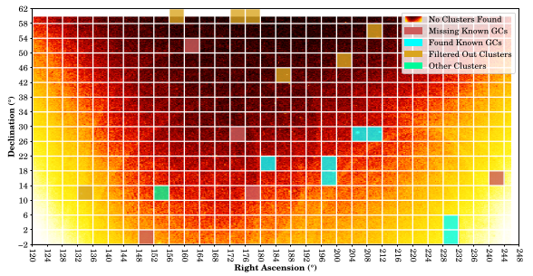
Area 1
8 clusters were found:
7 out of 12 known GCs
The Regulus Dwarf Galaxy

Slide 23
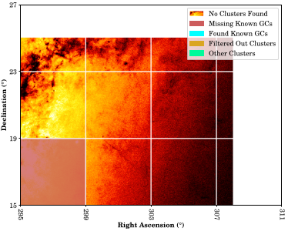
Area 2: 4°×4°
Nothing was found

Slide 24
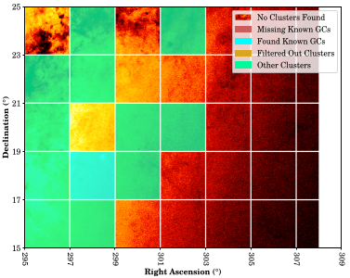
Area 2: 2°×2°
18 clusters were found total:
1 out of 1 known GCs found
Most could not be attributed to a known stellar structure

Slide 25
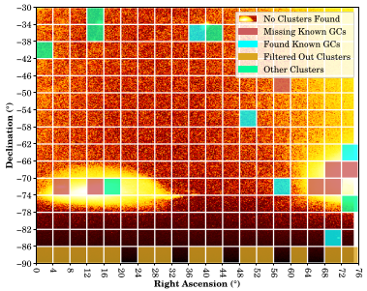
Area 3
11 clusters were found
5 out of 17 known GCs
3 Galaxies
1 Dwarf Galaxy
2 OCs
24 rasters that would contain an identified cluster were filtered away by BlobDoG.
Notes:
None of which contained a known GC.

Slide 26
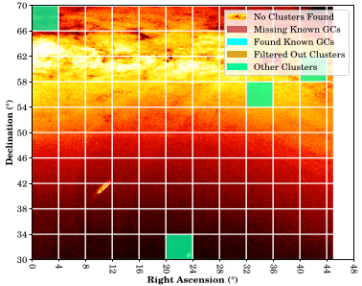
Area 4
4 clusters were found
Triangulum Galaxy
2 OC
HII region

Slide 27
Conclusion
With a BlobDoG threshold of 0.2 it keeps 80% (24 out of 30) of the known GCs.
BlobDoG operates as an effective exclusion criteria but it is not yet perfect in maintaining all known GCs.
Further research on optimizing the threshold and alternate rasterization schemes might improve the performance.
Across the full pipeline, the system is able to identify 43% (13 GCs out of the 30) known GCs
27 out of the 41 clusters that were identified corresponded to a known stellar structure:
13 of these corresponded to GCs
14 corresponded to some other pre-existing stellar structure.
The output of the clustering phase currently only filters based on a minimum number of stars contained within a cluster. However, this output could be easily refined to reduce false positives by incorporating previous techniques for identifying globular clusters (such as consulting mean luminosity or metallicity).
The pipeline does not identify the majority of the GCs that exist, but for those that it is able to identify, it can pinpoint their locations quite accurately. Further research in tuning the parameters and steering the behavior of the ants would be required and is expected to expand the number of GCs identified by the pipeline.
Notes:
And Further research in the same slide

Slide 28
Questions?

